Slide 1
Smart Hatch
Excel to ppt

Slide 2
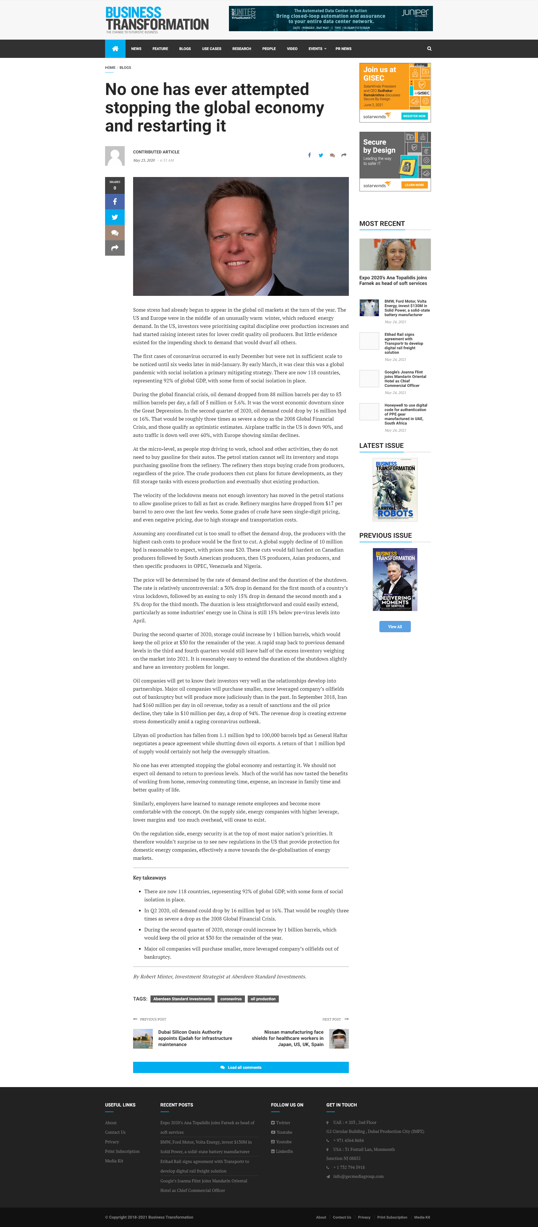
Screenshot
:
localhost:3003/imagedownload/1621966579865t1.png
Headline
:
No one has ever attempted stopping the global economy and restarting it
DATE
:
23-May-2020 10:51AM
Influencer
:
Bizness trandform
Country
:
United Arab Emirates
Language
:
English
Reach
:
21401
AVE
:
2050
Sentiment
:
Negative

Slide 3

Screenshot
:
localhost:3003/imagedownload/1621966587659t10.png
Headline
:
Just Dummy
DATE
:
25-May-2020 10:51AM
Influencer
:
Stackoverflow
Country
:
India
Language
:
Hindi
Reach
:
1650
AVE
:
2020
Sentiment
:
Positive

Slide 4
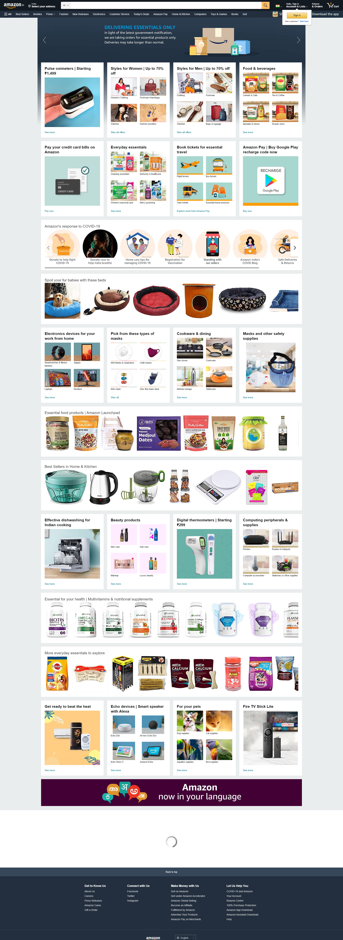
Screenshot
:
localhost:3003/imagedownload/1621966590393t19.png
Headline
:
Text dummy
DATE
:
23-May-2020 10:51AM
Influencer
:
featurized
Country
:
us
Language
:
eng
Reach
:
210
AVE
:
222
Sentiment
:
Positive

Slide 5

Screenshot
:
localhost:3003/imagedownload/1621966597421t28.png
Headline
:
Stack
DATE
:
23-May-2020 10:51AM
Influencer
:
Stackoverflow
Country
:
India
Language
:
Hn
Reach
:
99
AVE
:
33
Sentiment
:
Negative

